Slide 1

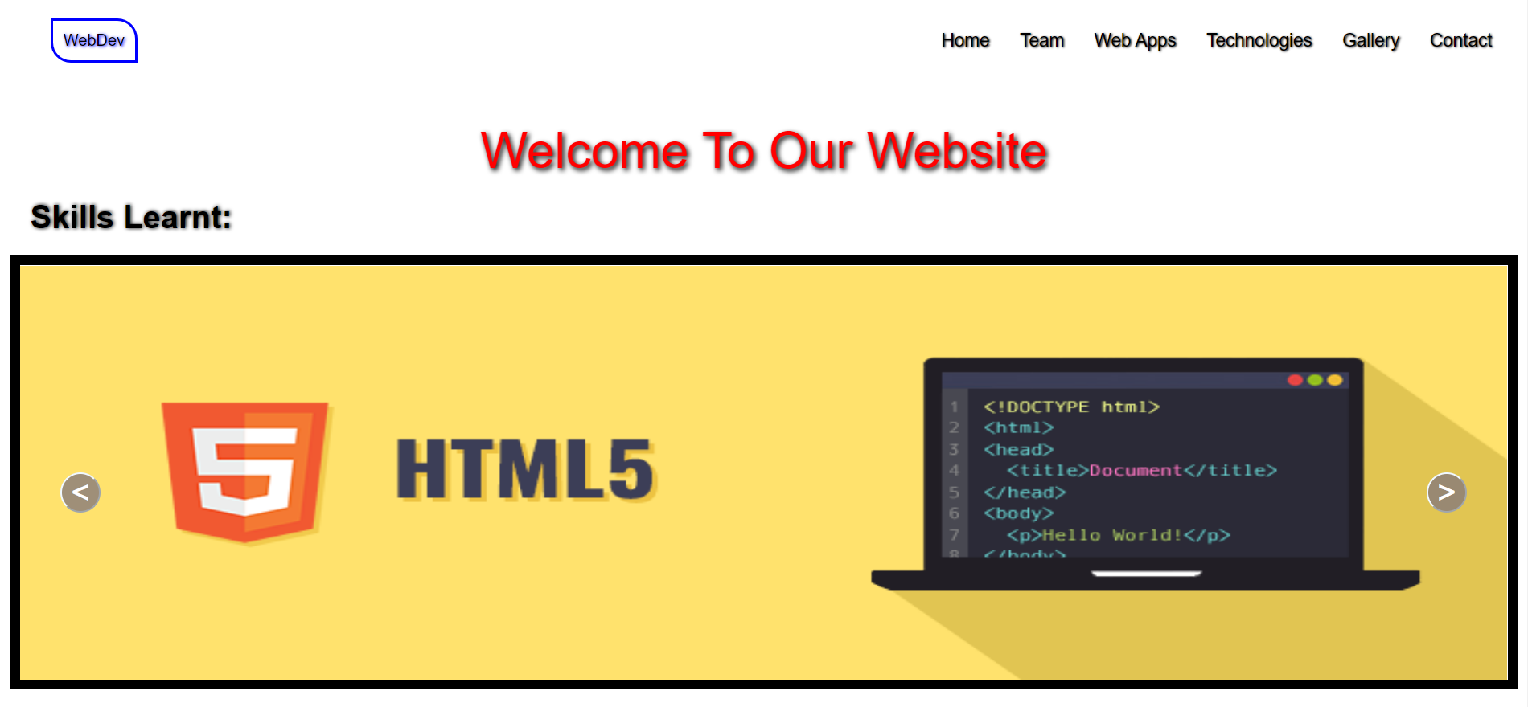
Web Development Project
https://anikateagrawal.github.io/WebBootcamp1.0-main/pages/Project.html

Slide 2
Languages
HTML-> The Hypertext markup language which is used for creating web pages and web applications.
CSS-> Cascading Style Sheets is a style sheet language which is used to describe the look and formatting of a document written in markup language.
JavaScript-> JavaScript is a scripting language used to create and control dynamic website content, i.e. anything that moves, refreshes, or otherwise changes on your screen without requiring you to manually reload a web page.
Bootstrap-> a collection of HTML, CSS, and JavaScript tools for creating and building web pages and web applications. It is a free and open source project

Slide 3
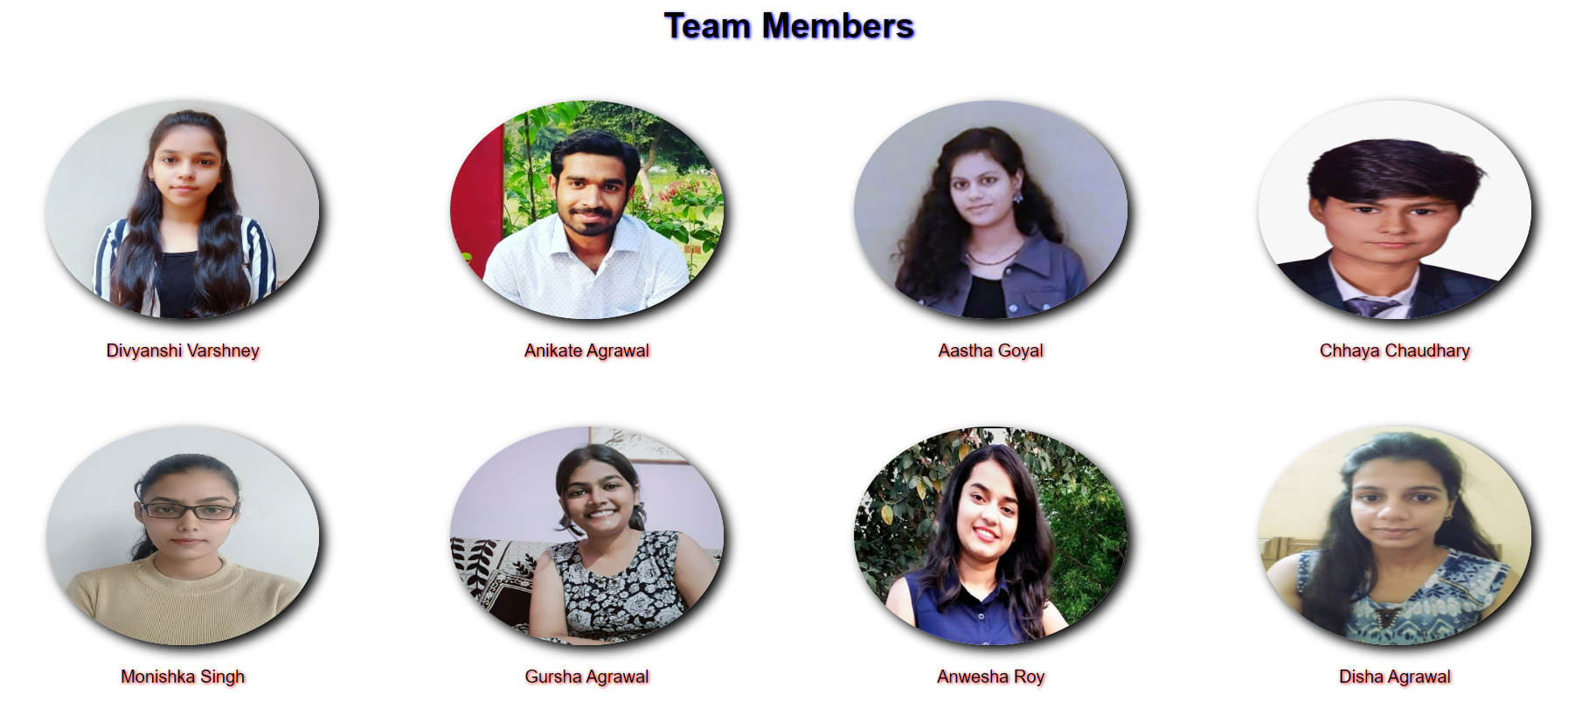
Team Members
Divyanshi Varshney 201500233
Anikate Agrawal 201500088
Aastha Goyal 201500004
Anwesha Roy 201500135
Chhaya Chaudhary 201500200
Monishka Singh 201500412
Gursha Agrawal 201500259
Disha Agrawal 201500225

Slide 4
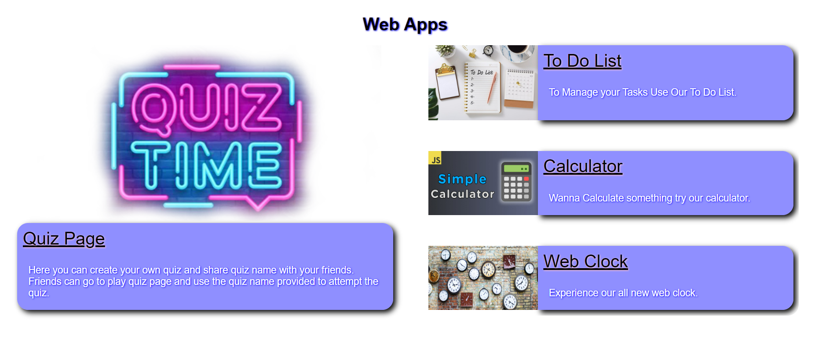
Web Apps

Slide 5
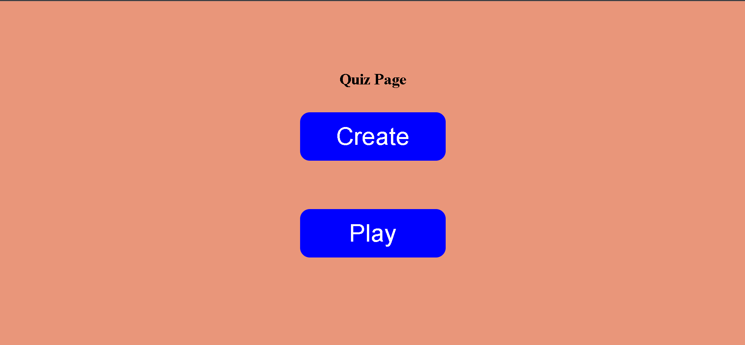
Quiz Page
Here you can create your own quiz and share quiz name with your friends
Live Link->https://anikateagrawal.github.io/WebBootcamp1.0-main/quizapp/index.html

Slide 6
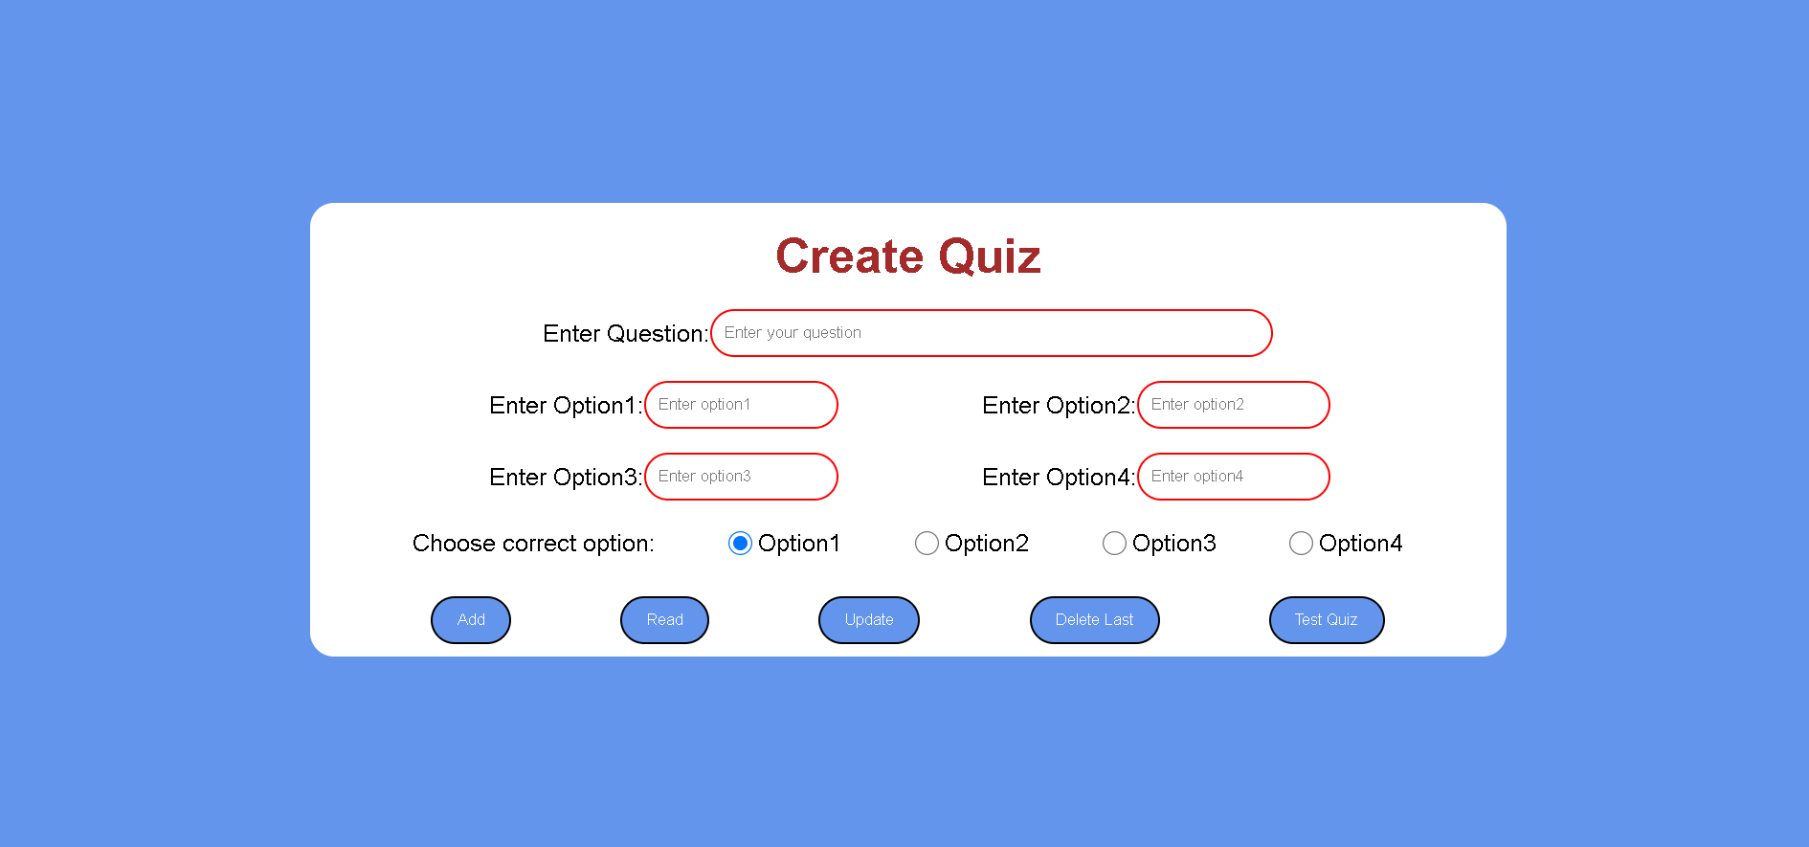
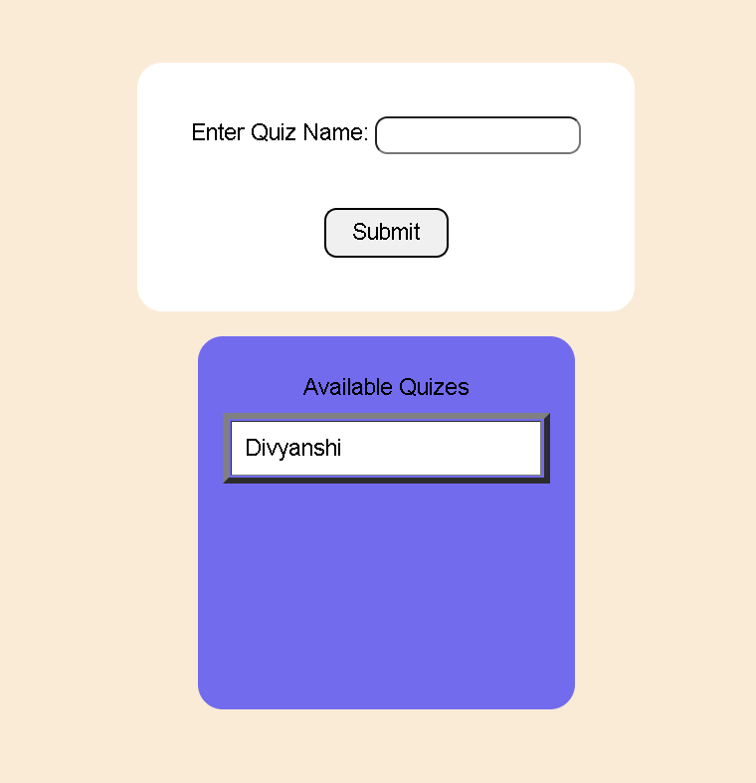

Slide 7
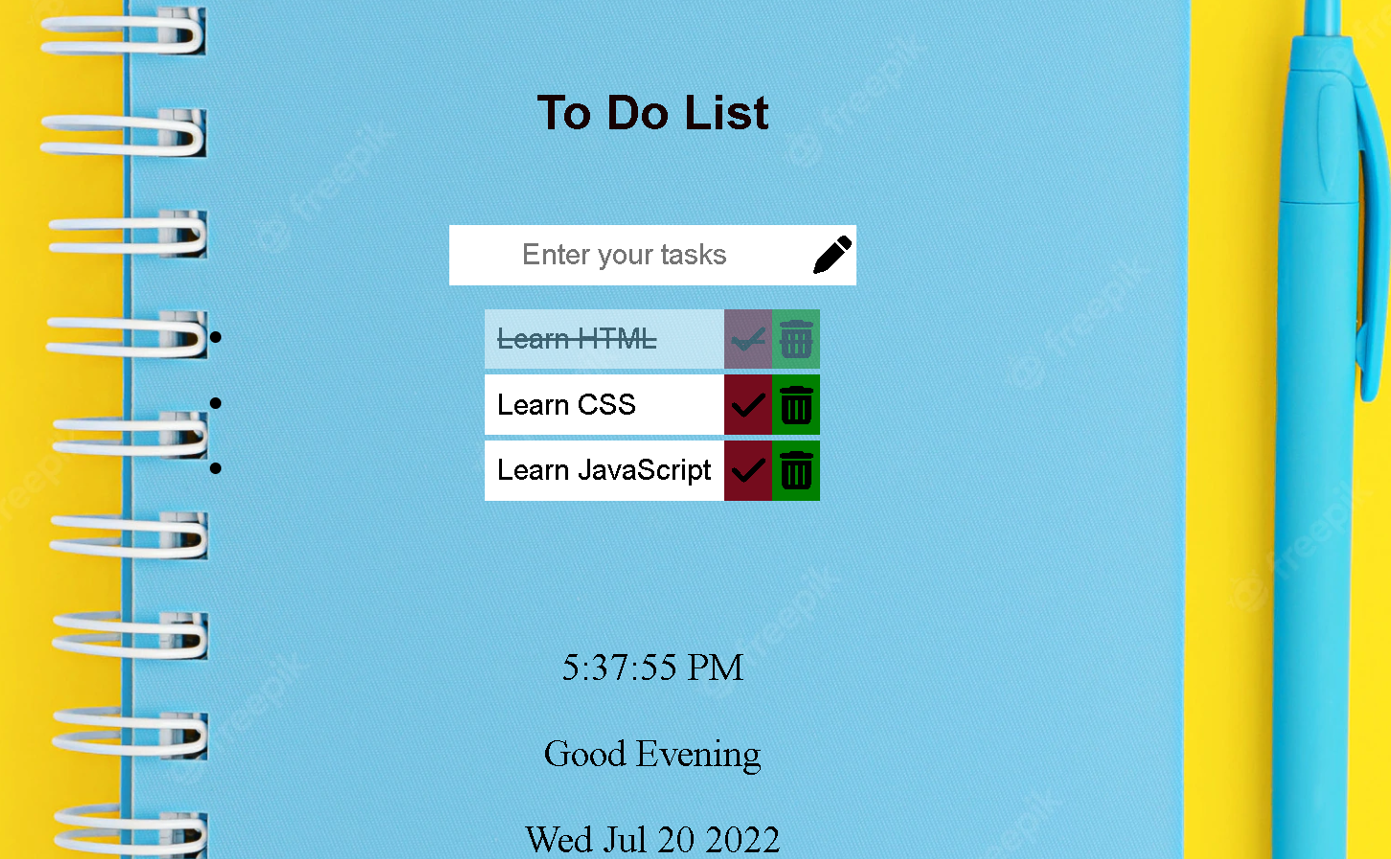
To-Do List
By Using To-Do list you can manage your Tasks easily
Live Link->https://123moni-source.github.io/To-do-list/

Slide 8
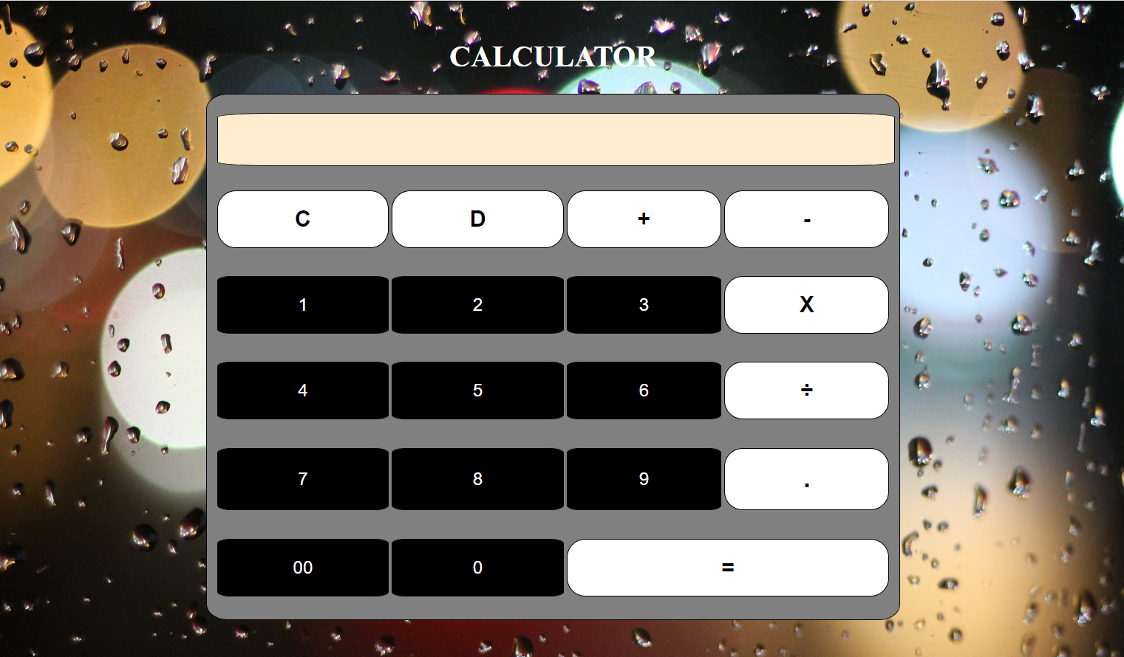
Calculator
You can easily get the answers of the complex problems in just few seconds.
Live Link->https://divyanshi-varshney2002.github.io/Web-Development/html/Calculator.html

Slide 9

Web Clock
Here you get to know the live time
Live Link->https://chhaya7817.github.io/Live-clock/

Slide 10
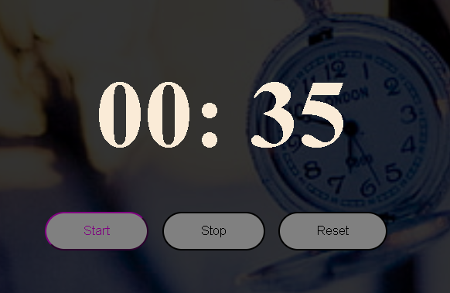
Stop Watch
Wanna Stop Time? Use our Stop Watch
Live Link->https://anwesha294.github.io/sw2.github.io/

Slide 11
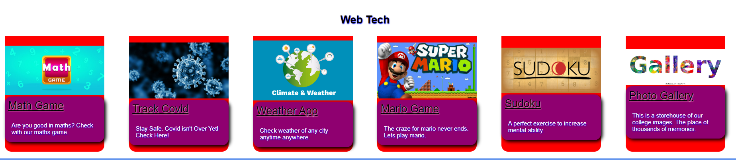
Web Tech

Slide 12
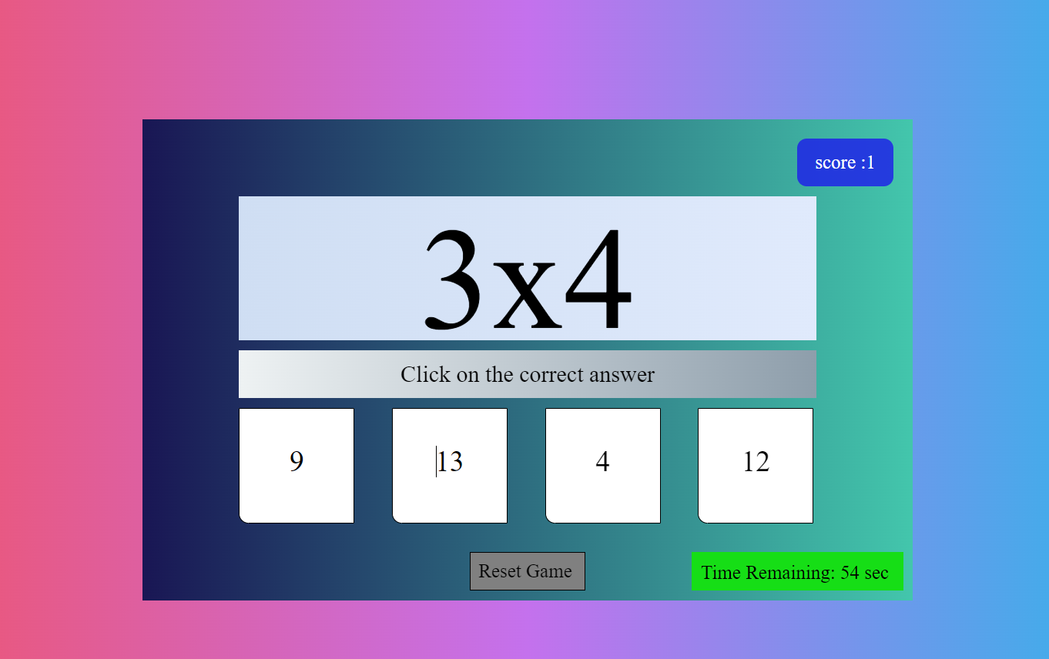
Math Game
Here you can check how good you are in Maths without getting bored.
Live Link->https://chhaya7817.github.io/Maths-Game/

Slide 13
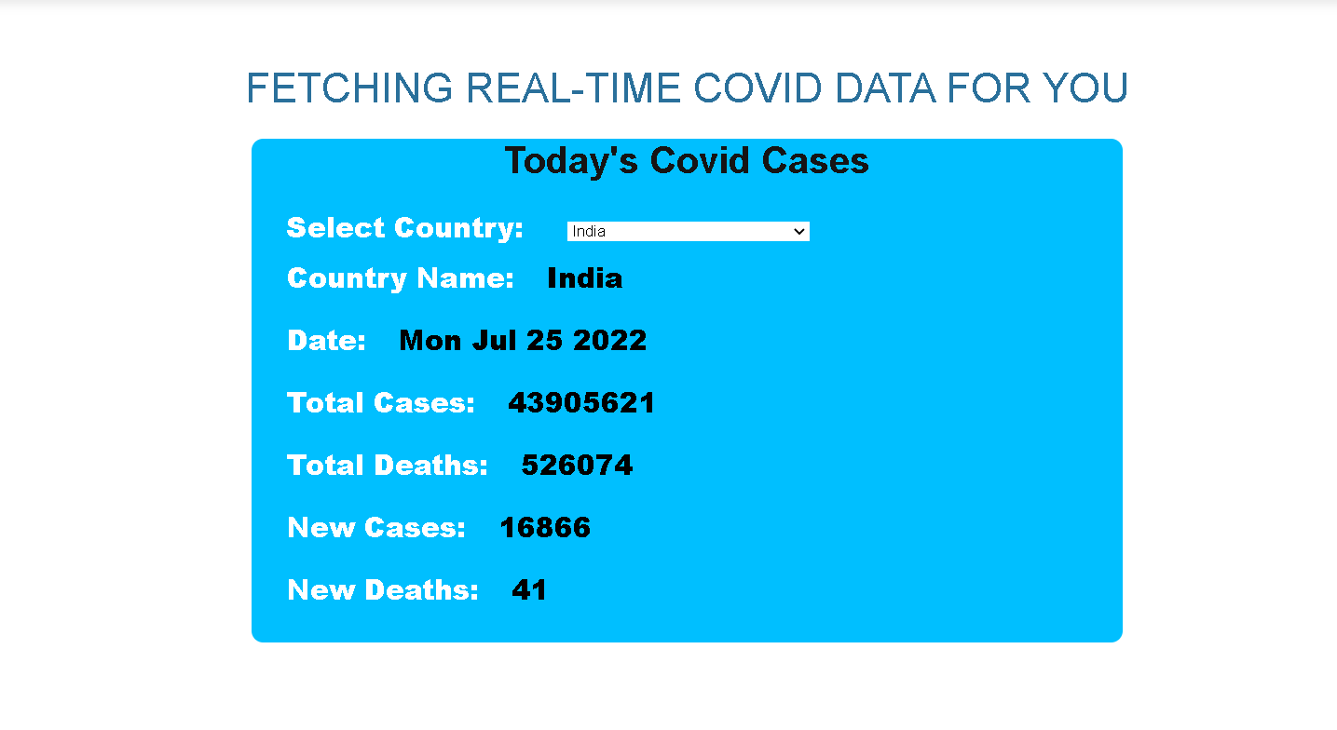
Track Covid
Here you can find out no. of cases and deaths of covid of any Location.
Live Link->https://123moni-source.github.io/Website/

Slide 14
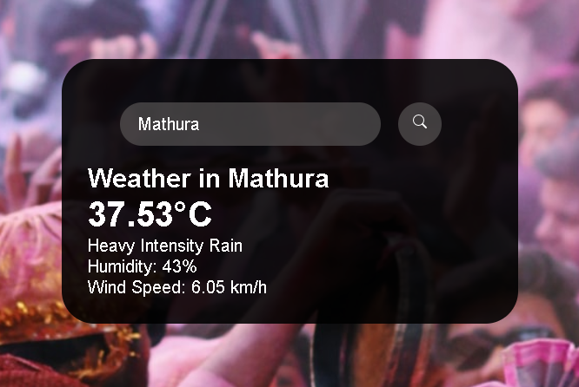
Weather App
Here You can Find out the climate of any place.
Live Link-> https://divyanshi-varshney2002.github.io/Web-Development/html/weather.html

Slide 15
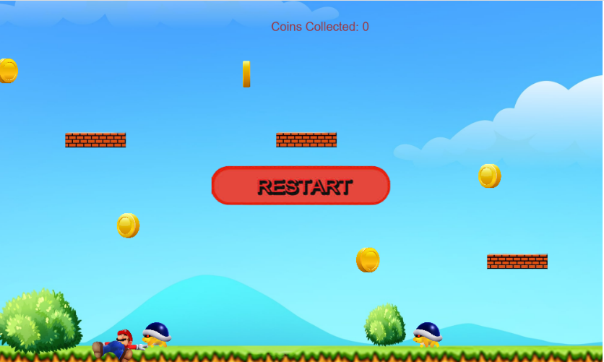
Mario Game
Here your childhood favourite game
Live Link->https://anikateagrawal.github.io/WebBootcamp1.0-main/Mario-Level-1-master/index.html

Slide 16
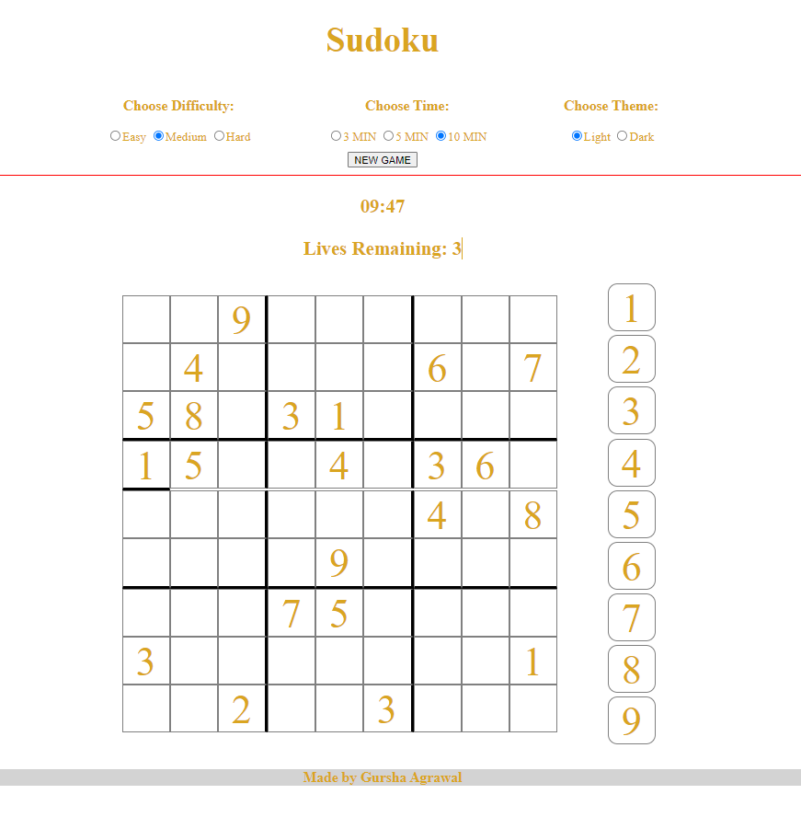
SudoKu
If you are a sudoku lover then get ready to have fun
Live Link->https://gurshaagrawal.github.io/sudoku.github.io/

Slide 17

Gallery
Place of Thousand of memories
Live Link->https://agrawaldisha.github.io/WebDev/html/flexboxphotogallery.html

Slide 18
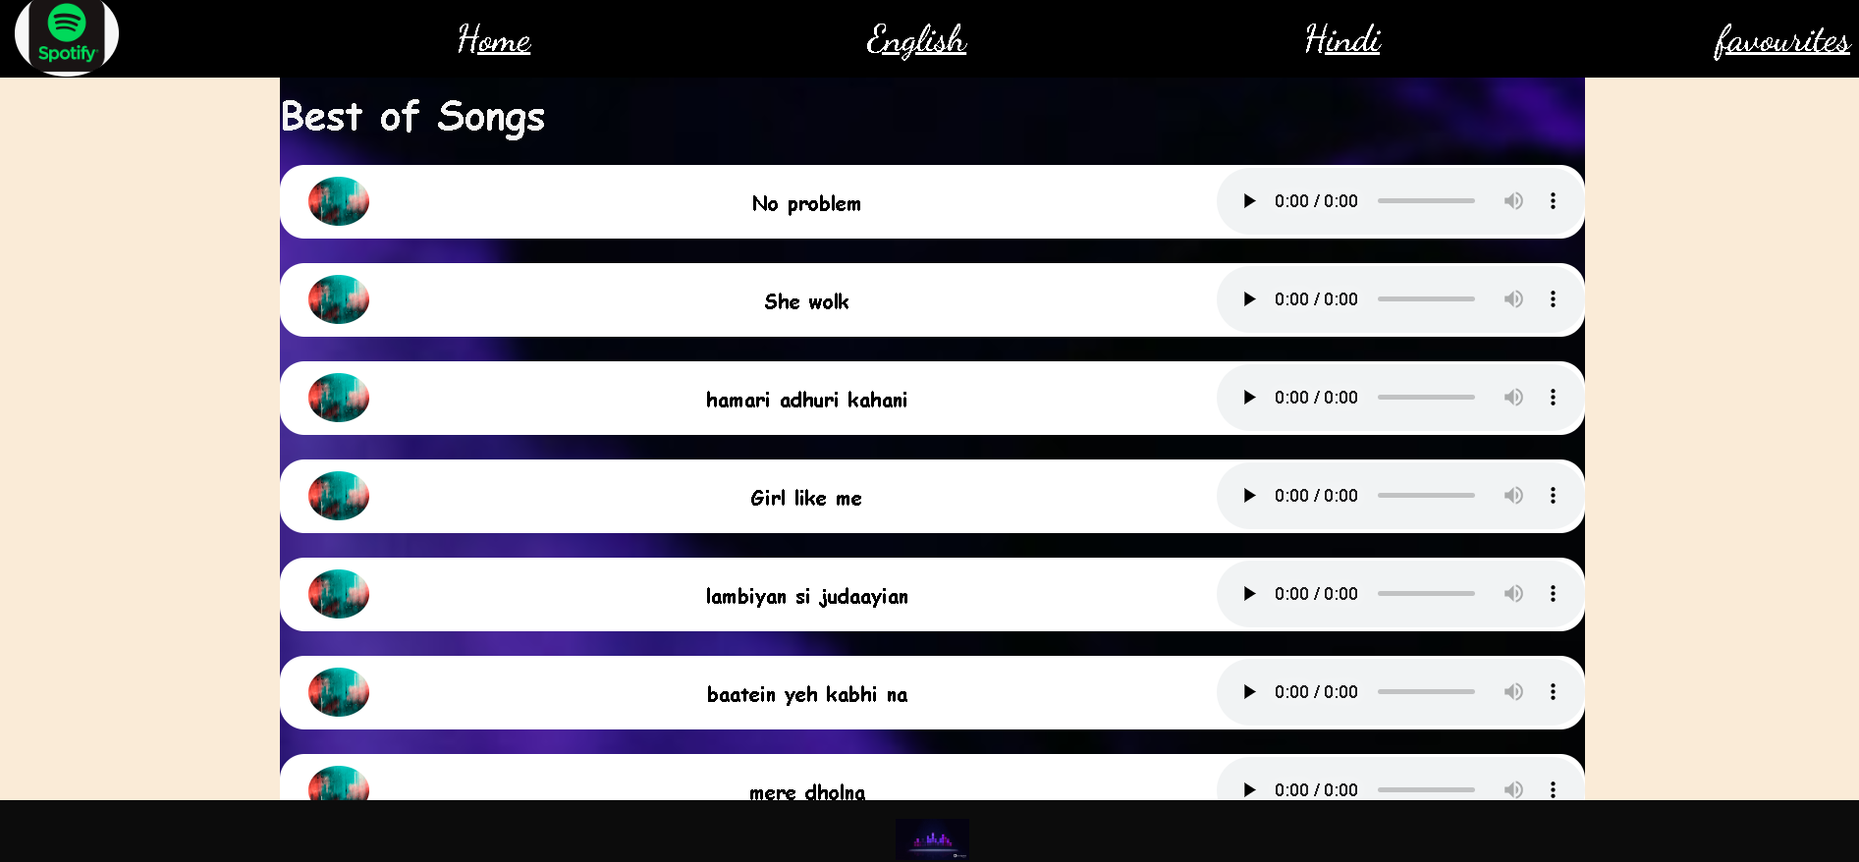
Music Player
To relieve stress , use our music player.
Live Link->https://anwesha294.github.io/muscplayer3.github.io/

Slide 19
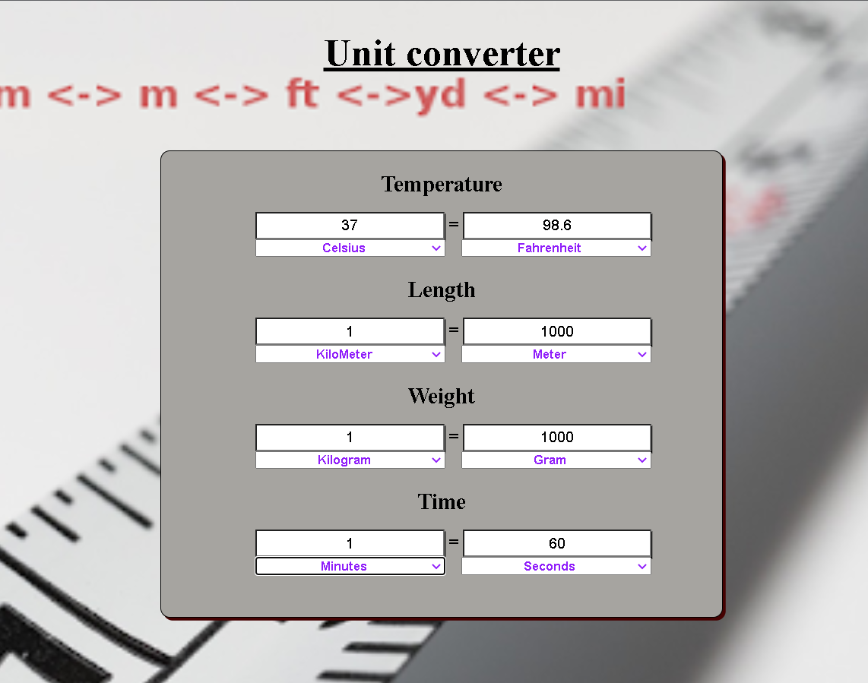
Unit Convertor
Here you can easily do conversion b/w different types of measurement.
Live Link->https://aasthagoyal09.github.io/WebDevelopmentProject/

Slide 20
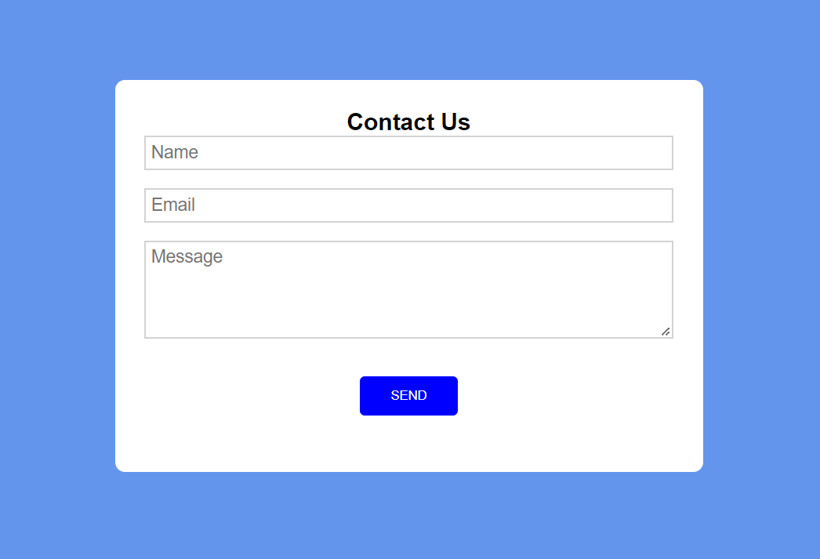
Contact Us
You can send us a message anytime you want.

Slide 21
Thank You
We are ready to receive your valuable feedback.

